Slide 1
Warm UP 4/27
Given f(x)= x⁴ –22x³ +39x² +14x+120 , answer the following questions:
How many zeros are there for this polynomial in the set of complex numbers?
Following the Rational Root Theorem, state the list of potential rational zeros for f(x).
Is x – 20 a factor of x⁴ –22x³ +39x² +14x+120 by.?
Find all other roots of the polynomial.

Slide 2
Unit 7: Polynomial Functions
LG 7-1 Characteristics of Polynomials!
LG 7-2 Graphing Polynomials!
TEST May 9th

Slide 3
Important dates for the semester
5/3 last day for exemption requirements
5/9 unit 7 test
5/10 SMI in room 925
5/12 last day for makeup work/reassessments
5/22 unit 8 test (our last one!)

Slide 4
LG 7-1 Analyzing Graphs
of Polynomials
Objective: To use graphs to make statements about functions.

Slide 5
Vocabulary
End Behavior: the value of f(x) as x approaches positive and negative infinity
Multiplicity: the number of times a root occurs at a given point of a polynomial equation.

Slide 6
Graphs of polynomials are smooth and continuous.
No sharp corners or cusps
No gaps or holes, can be drawn without lifting pencil from paper
This IS the graph
of a polynomial
This IS NOT the graph
of a polynomial

Slide 7
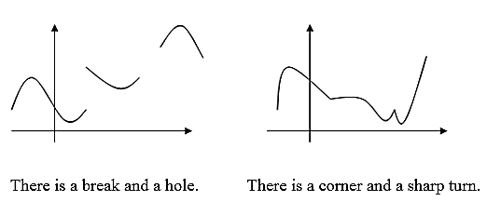
More NON-examples of graphs of non-polynomial functions

Slide 8
Graphs of Polynomials
The graphs of polynomials of degree 0 or 1 are lines.
The graphs of polynomials of degree 2 are parabolas.
The greater the degree of the polynomial, the more complicated its graph can be.
The graph of a polynomial function is always a smooth curve; that is it has no breaks or corners.

Slide 9
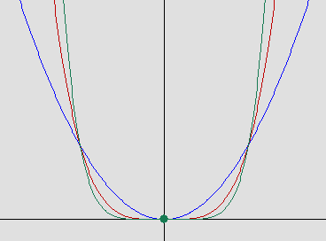
Let’s look at the graph of where n is an even integer.
and grows steeper on either side
Notice each graph looks similar to x² but is wider and flatter near the origin between –1 and 1
The higher the power, the flatter and steeper

Slide 10
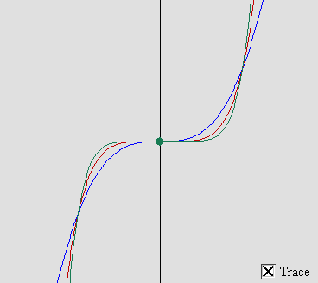
Let’s look at the graph of where n is an odd integer.
Notice each graph looks similar to x³ but is wider and flatter near the origin between –1 and 1
and grows steeper on either side
The higher the power, the flatter and steeper

Slide 11




Investigation
Look at the graphs for each function on your GDC and observe the end behavior for the polynomial functions.
What does the degree of the polynomial function tell you about its end behavior?
Function | Left End | Right End | Degree

Slide 12

and
LEFT
RIGHT
END BEHAVIOR OF A GRAPH
The degree of the polynomial along with the sign of the coefficient of the term with the highest power will tell us about the left and right hand behavior of a graph.

Slide 13
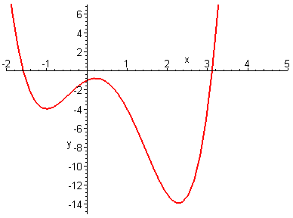
Even degree polynomials rise on both the left and right hand sides of the graph (like x²) if the coefficient is positive.
Any additional terms may cause the graph to have some turns near the center but will always have the same left and right hand behavior determined by the highest powered term.
left hand behavior: rises
right hand behavior: rises

Slide 14
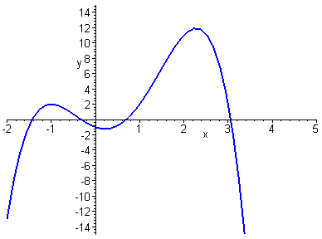
Even degree polynomials fall on both the left and right hand sides of the graph (like - x²) if the coefficient is negative.
turning points in the middle
left hand behavior: falls
right hand behavior: falls

Slide 15
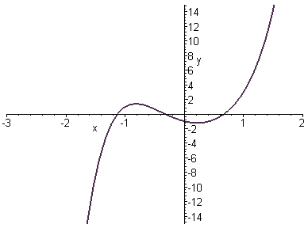
Odd degree polynomials fall on the left and rise on the right hand sides of the graph (like x³) if the coefficient is positive.
turning Points in the middle
right hand behavior: rises
left hand behavior: falls

Slide 16
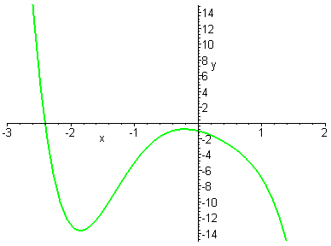
Odd degree polynomials rise on the left and fall on the right hand sides of the graph (like x³) if the coefficient is negative.
turning points in the middle
left hand behavior: rises
right hand behavior: falls

Slide 17
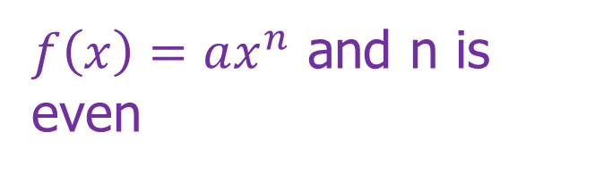
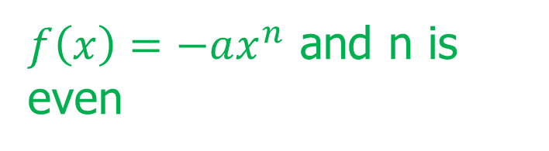
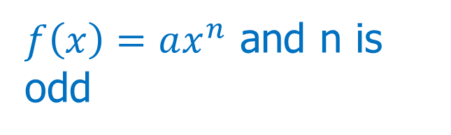
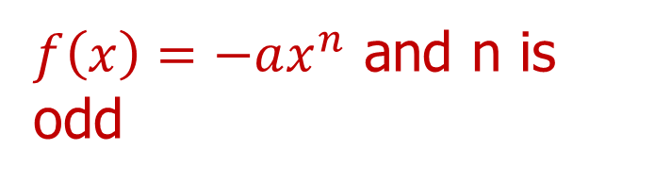
End Behavior

Slide 18
End Behavior
the behavior of the graph as x gets very large (approaches positive infinity) OR as x gets very small (or approaches negative infinity).
Notation:
  The very far left end of a graph:
  The very far right end of a graph:
Which term of the polynomial function is most important when determining the end behavior of the function?

Slide 19
End Behavior
Degree | Leading Coefficient | End Behavior
Even | Positive
Even | Negative
Odd | Positive
Odd | Negative

Slide 20
Indicate if the degree of the polynomial function shown in the graph is odd or even and indicate the sign of the leading coefficient

Slide 21
practice
End behavior exit ticket

Slide 22
Warm UP 4/28
In your groups, sort the cards.
  Green cards sort onto the green paper
  Orange cards sort onto the orange paper
Write the NUMBER of the card on the paper ONLY.
Please DO NOT write ON the cards ☺

Slide 23
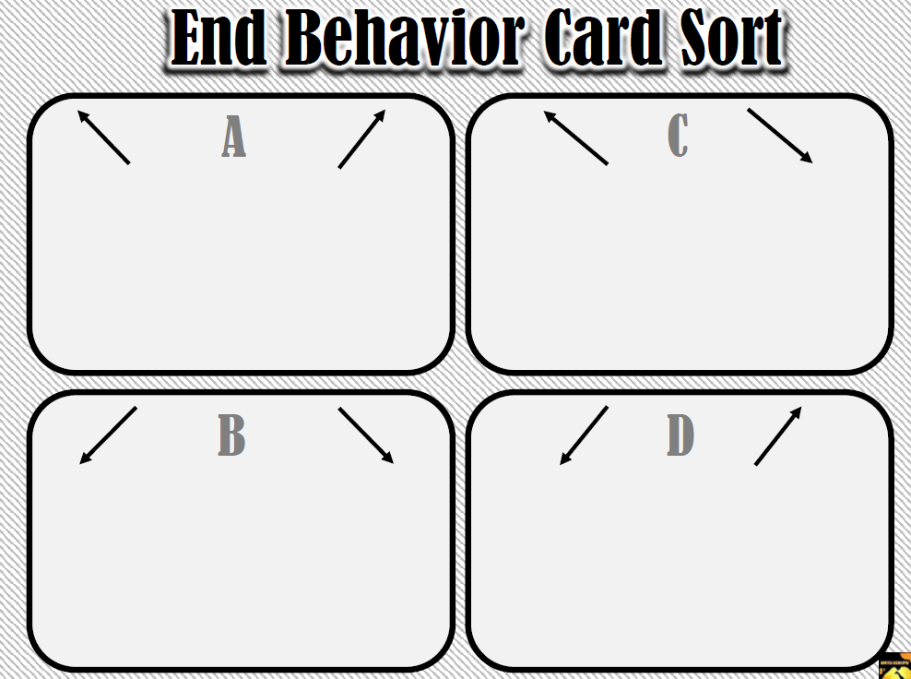

Slide 24
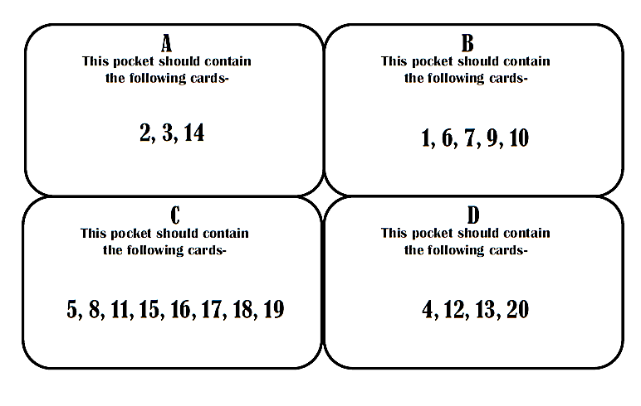
5,

Slide 25


Slide 26
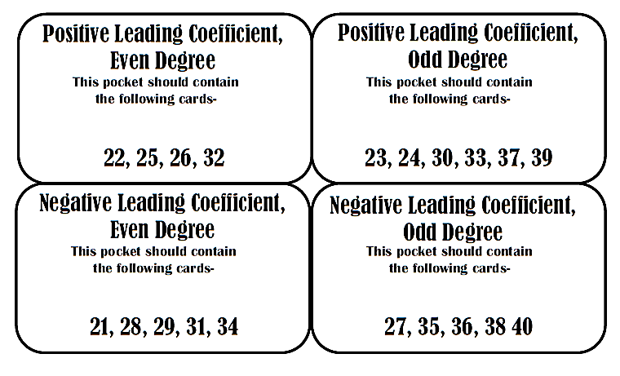

Slide 27
Investigation
Look at the following functions on your graphing calculator and use the graph to fill in the table:
Function | Zeros | Cross | Bounce | Degree

Slide 28
Multiplicity
This refers to the number of times the root is a zero of the function. We can have “repeated” zeros.
Odd Multiplicity: f crosses the x-axis at its root; f(x) changes signs
Even Multiplicity: f “kisses” or is tangent to the x-axis at it root; f(x) doesn’t change signs

Slide 29
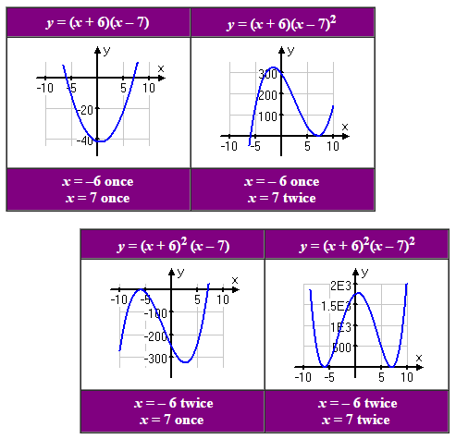
Multiplicity
All four graphs have the same zeros, at x = 6 and x = 7, but the multiplicity of the zero determines whether the graph crosses the x-axis at that zero or if it instead turns back the way it came.

Slide 30
Polynomial Functions
Multiplicity
The number of times a factor (m) of a function is repeated is referred to its multiplicity (zero multiplicity of m).
Multiplicity of an Even Exponent
The graph of the function touches the x-axis but does not cross it. Think of this as a “bounce”
Multiplicity of an Odd Exponent
The graph of the function crosses the x-axis.

Slide 31
Multiplicity
Identify the zeros and their multiplicity
3 is a zero with a multiplicity of
1.
Graph crosses the x-axis.
-2 is a zero with a multiplicity of
3.
Graph crosses the x-axis.
-4 is a zero with a multiplicity of
1.
Graph crosses the x-axis.
7 is a zero with a multiplicity of
2.
Graph touches the x-axis.
-1 is a zero with a multiplicity of
1.
Graph crosses the x-axis.
4 is a zero with a multiplicity of
1.
Graph crosses the x-axis.
2 is a zero with a multiplicity of
2.
Graph touches the x-axis.

Slide 32
How many zeros are there in the polynomial h(x) = (x + 2)⁷(x² – 25)⁵, counting multiplicity?

Slide 33
Polynomial Functions
Write an equation for a possible function:
What is the degree of this function?
Describe the end behavior:

Slide 34
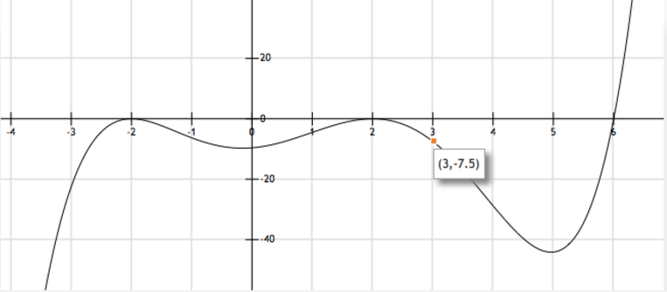
What is the exact equation for graph with –2 & 2 (double roots) and 6 (single root), going thru (3,–7.5)?

Slide 35
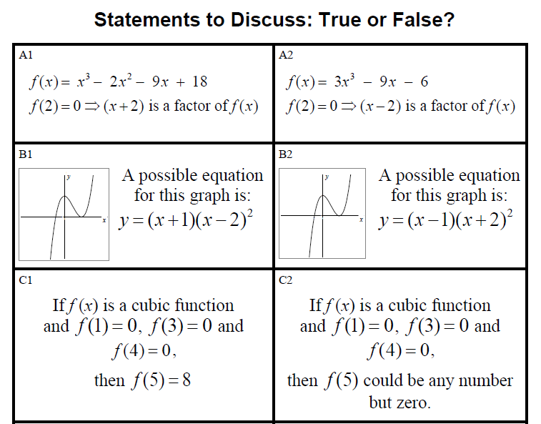

Slide 36
practice
Analyzing polynomials

Slide 37
Warm up 5/1
Write the factored form of a polynomial function that crosses the x-axis at x = –2 and x = 5 and touches the x-axis at x = 3.
Which of the zeros of the function must have a multiplicity greater than 1? Explain your reasoning.
Write two additional polynomial functions that meet the same conditions as described above.

Slide 38
Vocabulary
Relative Minimum: a point on the graph where the function is increasing as you move away from the point in the positive and negative direction along the horizontal axis.
Relative Maximum: a point on the graph where the function is decreasing as you move away from the point in the positive and negative direction along the horizontal axis.

Slide 39
Turning points of polynomial functions
QOD: What is the difference between local and absolute maxima and minima?
Polynomial functions have turning points corresponding to local maximum and minimum values.
The y – coordinate of a turning point is a local or relative maximum if the point is higher than all nearby points.
The y – coordinate of a turning point is a local or relative minimum if the point is lower than all nearby points.
Global or absolute minimums and maximums are the greatest or least values of the entire function.

Slide 40




Polynomial Functions
Turning Points
The point where a function changes directions from increasing to decreasing or from decreasing to increasing.
If a function has a degree of n, then it has at most n – 1 turning points.
If the graph of a polynomial function has t number of turning points, then the function has at least a degree of t + 1 .
What is the most number of turning points the following polynomial functions could have?
3-1
2
5-1
4
8-1
7
12-1
11

Slide 41
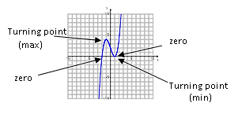
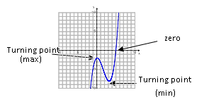
Identify the zeros and turning points (estimate the zeros and turning points)
Leading coefficient positive
3 real zeros (including the double zero) {-2, 1, 1}
2 turning points (-1,4); (1,0)
1 local max; 1 local min
Leading coefficient positive
1 real zero, 2 imaginary zeros {5}
2 turning points (0,-2); (3,-8)
1 local max; 1 local min

Slide 42
You Try
Leading coefficient _________
____real zeros
____turning points
____local max; ____local min
Leading coefficient _________
____real zeros
____turning points
____local max; ____local min

Slide 43
You Try
Leading coefficient _________
____real zeros
____turning points
____local max; ____local min
Leading coefficient _________
____real zeros
____turning points
____local max; ____local min

Slide 44
Other Characteristics:
Symmetry
Domain
Range
Intervals of increase and decrease

Slide 45
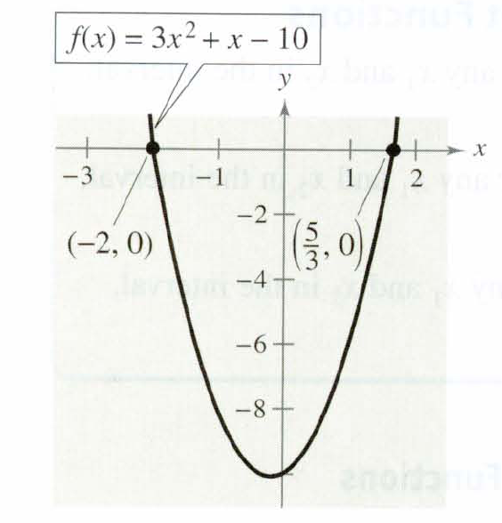
Example 1
Determine the following characteristics:
The zeros
The extrema
The domain
The range
the intervals of increase
The intervals of decrease
symmetry

Slide 46
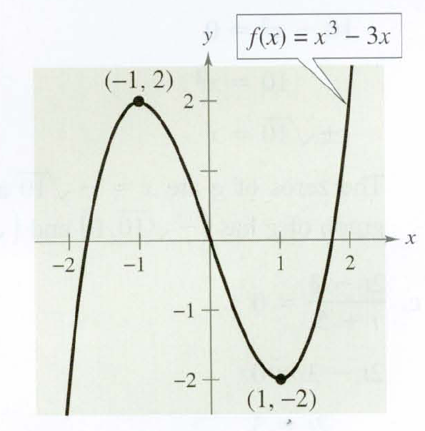
Example 2
Determine the following characteristics:
The zeros
The extrema
The domain
The range
the intervals of increase
The intervals of decrease
symmetry

Slide 47
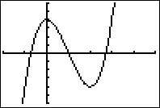
Example 3
Determine the following characteristics:
The zeros
The extrema
The domain
The range
the intervals of increase
The intervals of decrease
symmetry

Slide 48
Warm UP 5/2
Determine the following characteristics:
The zeros
The extrema
The domain
The range
the intervals of increase
The intervals of decrease
Symmetry
The y-intercept

Slide 49
Practice

Slide 50
Polynomial Patterns
Complete the task on polynomial characteristics.
DO IT!
What ever you don’t get done today is DUE TOMORROW
On the “Critical Points” section, please change #4 to read:
  Can you ever have an absolute maximum AND a local maximum be in the same location?
  Skip #5… sorry.

Slide 51
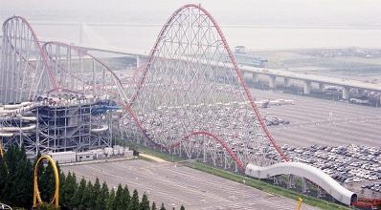
Applications of Polynomials
,
Fred, Elena, Michael, and Diane enjoy roller coasters. Whenever a new roller coaster opens at Six Flags, they try to be among the first to ride.
One Saturday, the four friends decide to ride a new coaster. While waiting in line, Fred notices that part of this coaster resembles the graph of a polynomial function that they have been studying in their math class.
The brochure for the coaster says that, for the first 10 seconds of the ride, the height of the coaster can be determined by where t is the time in seconds and h is the height in feet.

Slide 52
On your calculator, evaluate the graph of the polynomial function for the height of the roller coaster over time.
Find the height of the coaster at t = 0 seconds.
Find the height of the coaster 9 seconds after the ride begins.
Evaluate h(60). Does this answer make sense? Identify a practical (valid real life) domain of the ride for this model. (Hint: Mt. Everest is 29,028 feet tall)

Slide 53
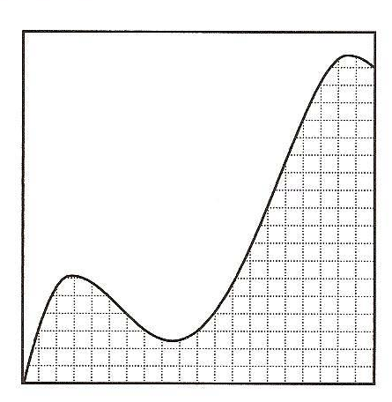
Next weekend, Fred, Elena, Michael, and Diane visit another roller coaster. Elena snaps a picture of part of the coaster from the park entrance. The diagram represents this part of the coaster.
Do you think quadratic, cubic, or quartic function would be the best model for this part of the coaster?

Slide 54
The part of the coaster captured by Elena and shown on her snap story is modeled by the function
Describe the increasing and decreasing intervals.
What is the height of the ride at t = 10 seconds?
What is the height of the ride at t = 12 seconds?
Identify a practical (valid real life) domain of the ride for this model.
Identify the corresponding range for the ride.

Slide 55

Diane loves coasters that dip into tunnels during the ride. Her favorite coaster is modeled by
Why do you think this model’s practical domain is only valid from t = 0 to t = 11?
At what time(s) is this coaster’s height 35 feet?
At what time(s) is the coaster at it’s maximum height?
Diane wants to know at what times the coaster dips below the ground. Locate all real zeros of this function. Clearly interpret the real-world meaning of these zeros.

Slide 56
Warm up 5/3

Slide 57
Graphing
Polynomial
Functions

Slide 58
How do we find the factors and roots of Polynomials?
To find the Roots/Zeros of Polynomials, you will use:
The Fundamental Theorem of Algebra
Descartes’ Rule of Signs
The Rational Root Theorem

Slide 59
Factoring Polynomials
Expressions are Factors of a Polynomial if, when they are multiplied, they equal that original polynomial:
(x - 3) and (x + 5) are factors of the polynomial
x = 3 and x = -5 are roots of they polynomial

Slide 60
Fundamental Theorem Of Algebra
A Polynomial Equation of the form P(x) = 0 of degree ‘n’ with complex coefficients has exactly ‘n’ roots.
These roots can be:
all real
all imaginary
or a combination of both real and imaginary

Slide 61
Real or Imaginary Roots?
So, if a polynomial has ‘n’ roots will its graph have ‘n’ x-intercepts?
In this example, the degree n = 3, and if we factor the polynomial, the roots are x = -2, 0, 2. We can also see from the graph that there are 3 x-intercepts.

Slide 62
Real or Imaginary Roots?
NO! Just because a polynomial has ‘n’ roots doesn’t mean that they are all REAL (which means they will touch the x-axis)!
In this example, the degree is still n = 3, but there is only one Real x-intercept or root at x = -1, the other 2 roots must have imaginary components.

Slide 63
Descartes’ Rule of Signs
Arrange the terms of the polynomial P(x) in standard form
The number of times the coefficients of the terms of P(x) change sign tells you the number of Positive Real Roots (or less by any even number)
The number of times the coefficients of the terms of P(-x) change sign tells you the number of Negative Real Roots (or less by any even number)
In the examples that follow, we will use Descartes’ Rule of Signs to predict the number of + and - Real Roots!

Slide 64
Find the Roots of a Polynomial
For higher degree polynomials, finding the roots (real and imaginary) is easier if we know one of the roots.
Descartes’ Rule of Signs can help get you started. Complete the table below:

Slide 65
Find all zeros.

Slide 66
A polynomial of degree n can have at most n-1 turning points. This doesn’t mean it has that many turning points but that’s the most it can have.
degree is 4 which is even and the coefficient is positive so the graph will look like x² looks off to the left and off to the right.
How do we determine what it looks like near the middle?
The graph can have at most 3 turning points

Slide 67
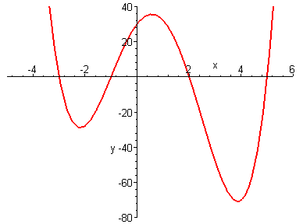
x and y intercepts would be useful and we know how to find those. To find the y intercept we put 0 in for x.
To find the x intercept we put 0 in for y.
Connect all of these with a smooth curve through the intercepts that has the correct left and right hand behavior.
To pass through these points, it will have 3 turns
(0,30)

Slide 68
Steps for Graphing a Polynomial
Determine left and right hand behaviour by looking at the highest power on x and the sign of that term.
Determine maximum number of turning points in graph by subtracting 1 from the degree.
Find and plot y intercept by putting 0 in for x
Find the zeros (x intercepts) by setting polynomial = 0 and solving.
Determine multiplicity of zeros.
Join the points together in a smooth curve touching or crossing zeros depending on multiplicity and using left and right hand behavior as a guide.

Slide 69
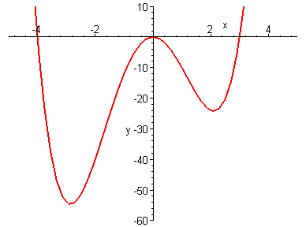
Let’s graph:
Steps:
Factor
Find & plot roots
Determine the multiplicity of the roots
Find & plot y-intercept
Determine the end behavior
Connect all the information above with a smooth curve

Slide 70
Let’s graph:
Determine left and right hand behavior by looking at the highest power on x and the sign of that term.
Determine maximum number of turns in graph by subtracting 1 from the degree.
Find and plot y intercept by putting 0 in for x
Find the zeros (x intercepts) by setting polynomial = 0 and solving.
Join the points together in a smooth curve touching or crossing zeros depending on multiplicity and using left and right hand behaviour as a guide.
Determine multiplicity of zeros.
0 multiplicity 2 (touches)
3 multiplicity 1 (crosses)
-4 multiplicity 1 (crosses)
Zeros are: 0, 3, -4
Multiplying out, highest power would be x⁴
Degree is 4 so maximum number of turns is 3
Here is the actual graph. We did pretty good. If we’d wanted to be more accurate on how low to go before turning we could have plugged in an x value somewhere between the zeros and found the y value. We are not going to be picky about this though since there is a great method in calculus for finding these maxima and minima.

Slide 71
What is we thought backwards? Given the zeros and the degree can you come up with a polynomial? Find a polynomial of degree 3 that has zeros –1, 2 and 3.
What would the function look like in factored form to have the zeros given above?
Multiply this out to get the polynomial.

Slide 72
Guidelines for Sketching Graphs Polynomial Functions
Zeros: Factor the polynomial to find all its real zeros; these are the x-intercepts of the graphs.
Multiplicities: Determine if the graph crosses or bounces at the zeros.
End Behavior: Determine the end behavior of the polynomial.
Graph: Sketch a smooth curve utilizing the behavior at the zeros and exhibits the required end behavior.

Slide 73
End Behavior/Multiplicity Practice
For each of the equations:
(a)Find the real zeros of f(x) and the multiplicity of each zero.
(b) Determine whether the graph crosses or touches the x-axis at the x-intercepts.
(c) Determine the end behavior of f(x).
(d) Sketch a graph of f(x) by hand. (Check using your calculator!)

Slide 74

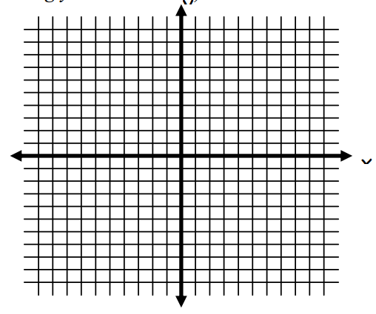
(a)Find the real zeros of f(x) and the multiplicity of each zero.
(b) Determine whether the graph crosses or touches the x-axis at the x-intercepts.
(c) Determine the end behavior
(d) Sketch a graph of f(x) by hand. (Check using your calculator!)

Slide 75
Warm up 5/4
Sketch a graph (by hand) of the following function:
f(x) =x(x-3)²(x²+4)
(a)Find the real zeros of f(x) and the multiplicity of each zero.
(b) Determine whether the graph crosses or touches the x-axis at the x-intercepts.
(c) Determine the end behavior
(d) Sketch a graph of f(x) by hand. (Check using your calculator!)

Slide 76

(a)Find the real zeros of f(x) and the multiplicity of each zero.
(b) Determine whether the graph crosses or touches the x-axis at the x-intercepts.
(c) Determine the end behavior
(d) Sketch a graph of f(x) by hand. (Check using your calculator!)

Slide 77

(a)Find the real zeros of f(x) and the multiplicity of each zero.
(b) Determine whether the graph crosses or touches the x-axis at the x-intercepts.
(c) Determine the end behavior
(d) Sketch a graph of f(x) by hand. (Check using your calculator!)

Slide 78
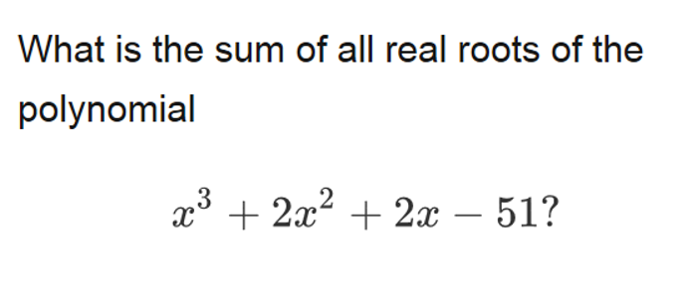
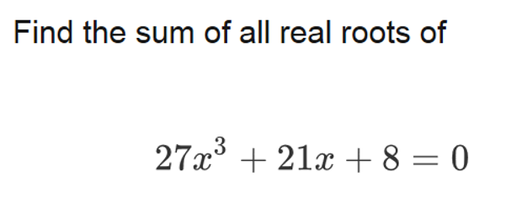
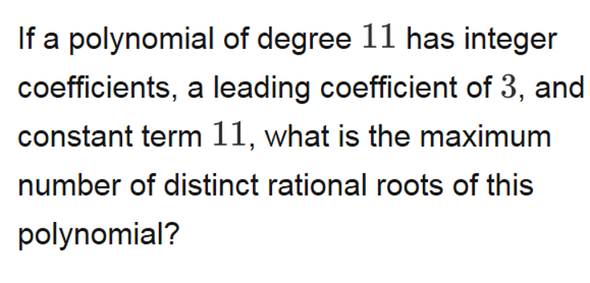
Warm UP
5/5
1)
2)
3)

Slide 79
POLYNOMIALS and THEOREMS
Theorems of Polynomial Equations
4 BIG Theorems to know about Polynomials
Rational Root Theorem
Descartes Rule
Irrational Root Theorem
Imaginary Root Theorem

Slide 80
Irrational Root Theorem
For a polynomial
If is a root, then is also a root
Irrationals always come in pairs. Real values do not. These are called CONJUGATES

Slide 81
Examples:
1. If a polynomial has a root
Other roots
Degree of Polynomial
2
2. If a polynomial has roots x = -1, x = 0,
Other roots
Degree of Polynomial
6

Slide 82
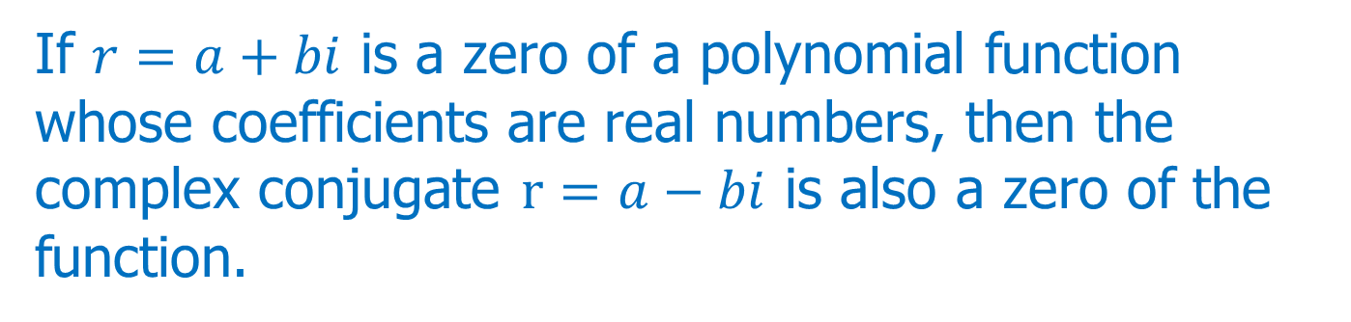
Imaginary Root Theorem
Complex Numbers
The complex number system includes real and imaginary numbers.
Standard form of a complex number is: a + bi.
a and b are real numbers.
Conjugate Pairs Theorem

Slide 83






Examples
1) A polynomial function of degree three has 2 and 3 + i as it zeros. What is the other zero?
2) A polynomial function of degree 5 has 4, 2 + 3i, and 5i as it zeros. What are the other zeros?
3) A polynomial function of degree 4 has 2 with a zero multiplicity of 2 and 2 – i as it zeros. What are the zeros?

Slide 84
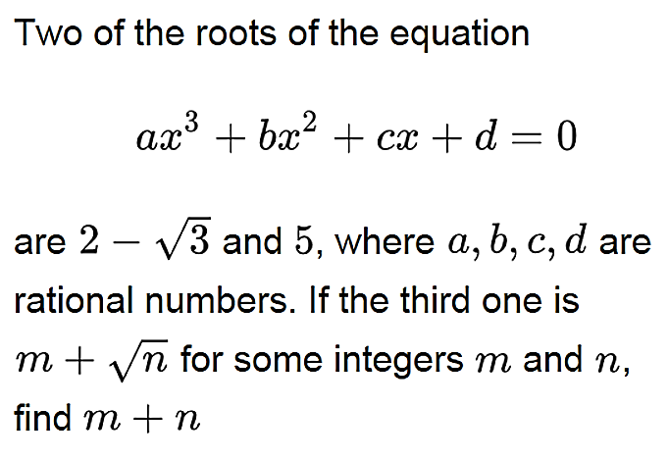

Slide 85
Find the remaining complex zeros of the given polynomial functions

Slide 86
Find the zeros of the given polynomial functions

Slide 87
Translating Polynomial Functions
Consider the cubic function
How can we graph
The graph is transformed with a horizontal translation of 2 to the left and a vertical translation of 3 down.

Slide 88
Representing Polynomials Task
ESSENTIAL QUESTIONS:
What is the relationship between graphs and algebraic representations of polynomials?
What is the connection between the zeros of polynomials, when suitable factorizations are available, and graphs of the functions defined by polynomials?
What is the connection between transformations of the graphs and transformations of the functions obtained by replacing f(x) by f(x + k), f(x) + k, -f(x), f(-x)?

Slide 89
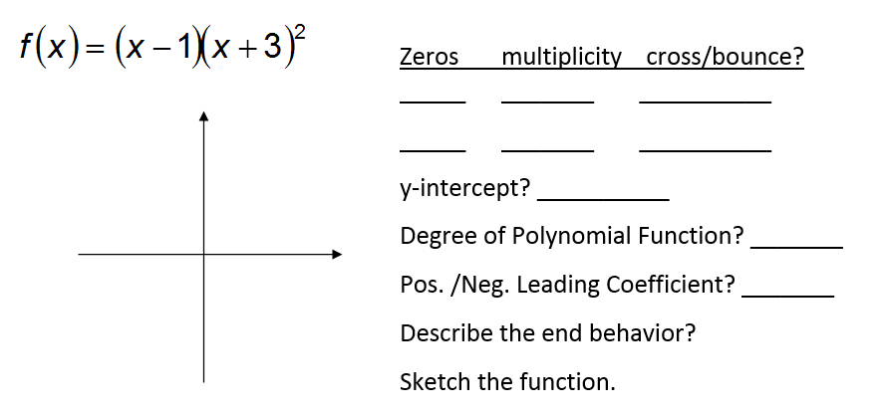
Warm UP 5/8

Slide 90
Review for test

